Slide 1


Bsc. IT (Set III)
CLASS PRESENTATION
GROUP ASSIGNMENT
Object Oriented Development with JAVA
CT032-3-2
Presentation Date : 15th August, 2021
Group Members
Name : Sandesh Subedi ‘A’
TP Number : NPI000040
COURIER SERVICE SYSTEM
Name : Nabin Chhetri
Subject Teacher : Mr. Sushil Adhikari
TP Number : NPI000032

Slide 2


Outline
Introduction
4
UML Diagrams
5
Use Case Diagram
5
Class Diagram
6
User Roles
7
Object Oriented Concepts
8
Advantages Object Oriented Concepts
11
System Limitations
12
Future Enhancements
11
Conclusion
12
References
13

Slide 3
Introduction
Courier Service System
A platform to convey goods from one location to other
Playing a role of bridge by facilitating safe and convincing delivery service
Entire system is built based on Java Programming Language (reinforced by OOP)
Offers handful of functionalities from profile management to order management

Slide 4
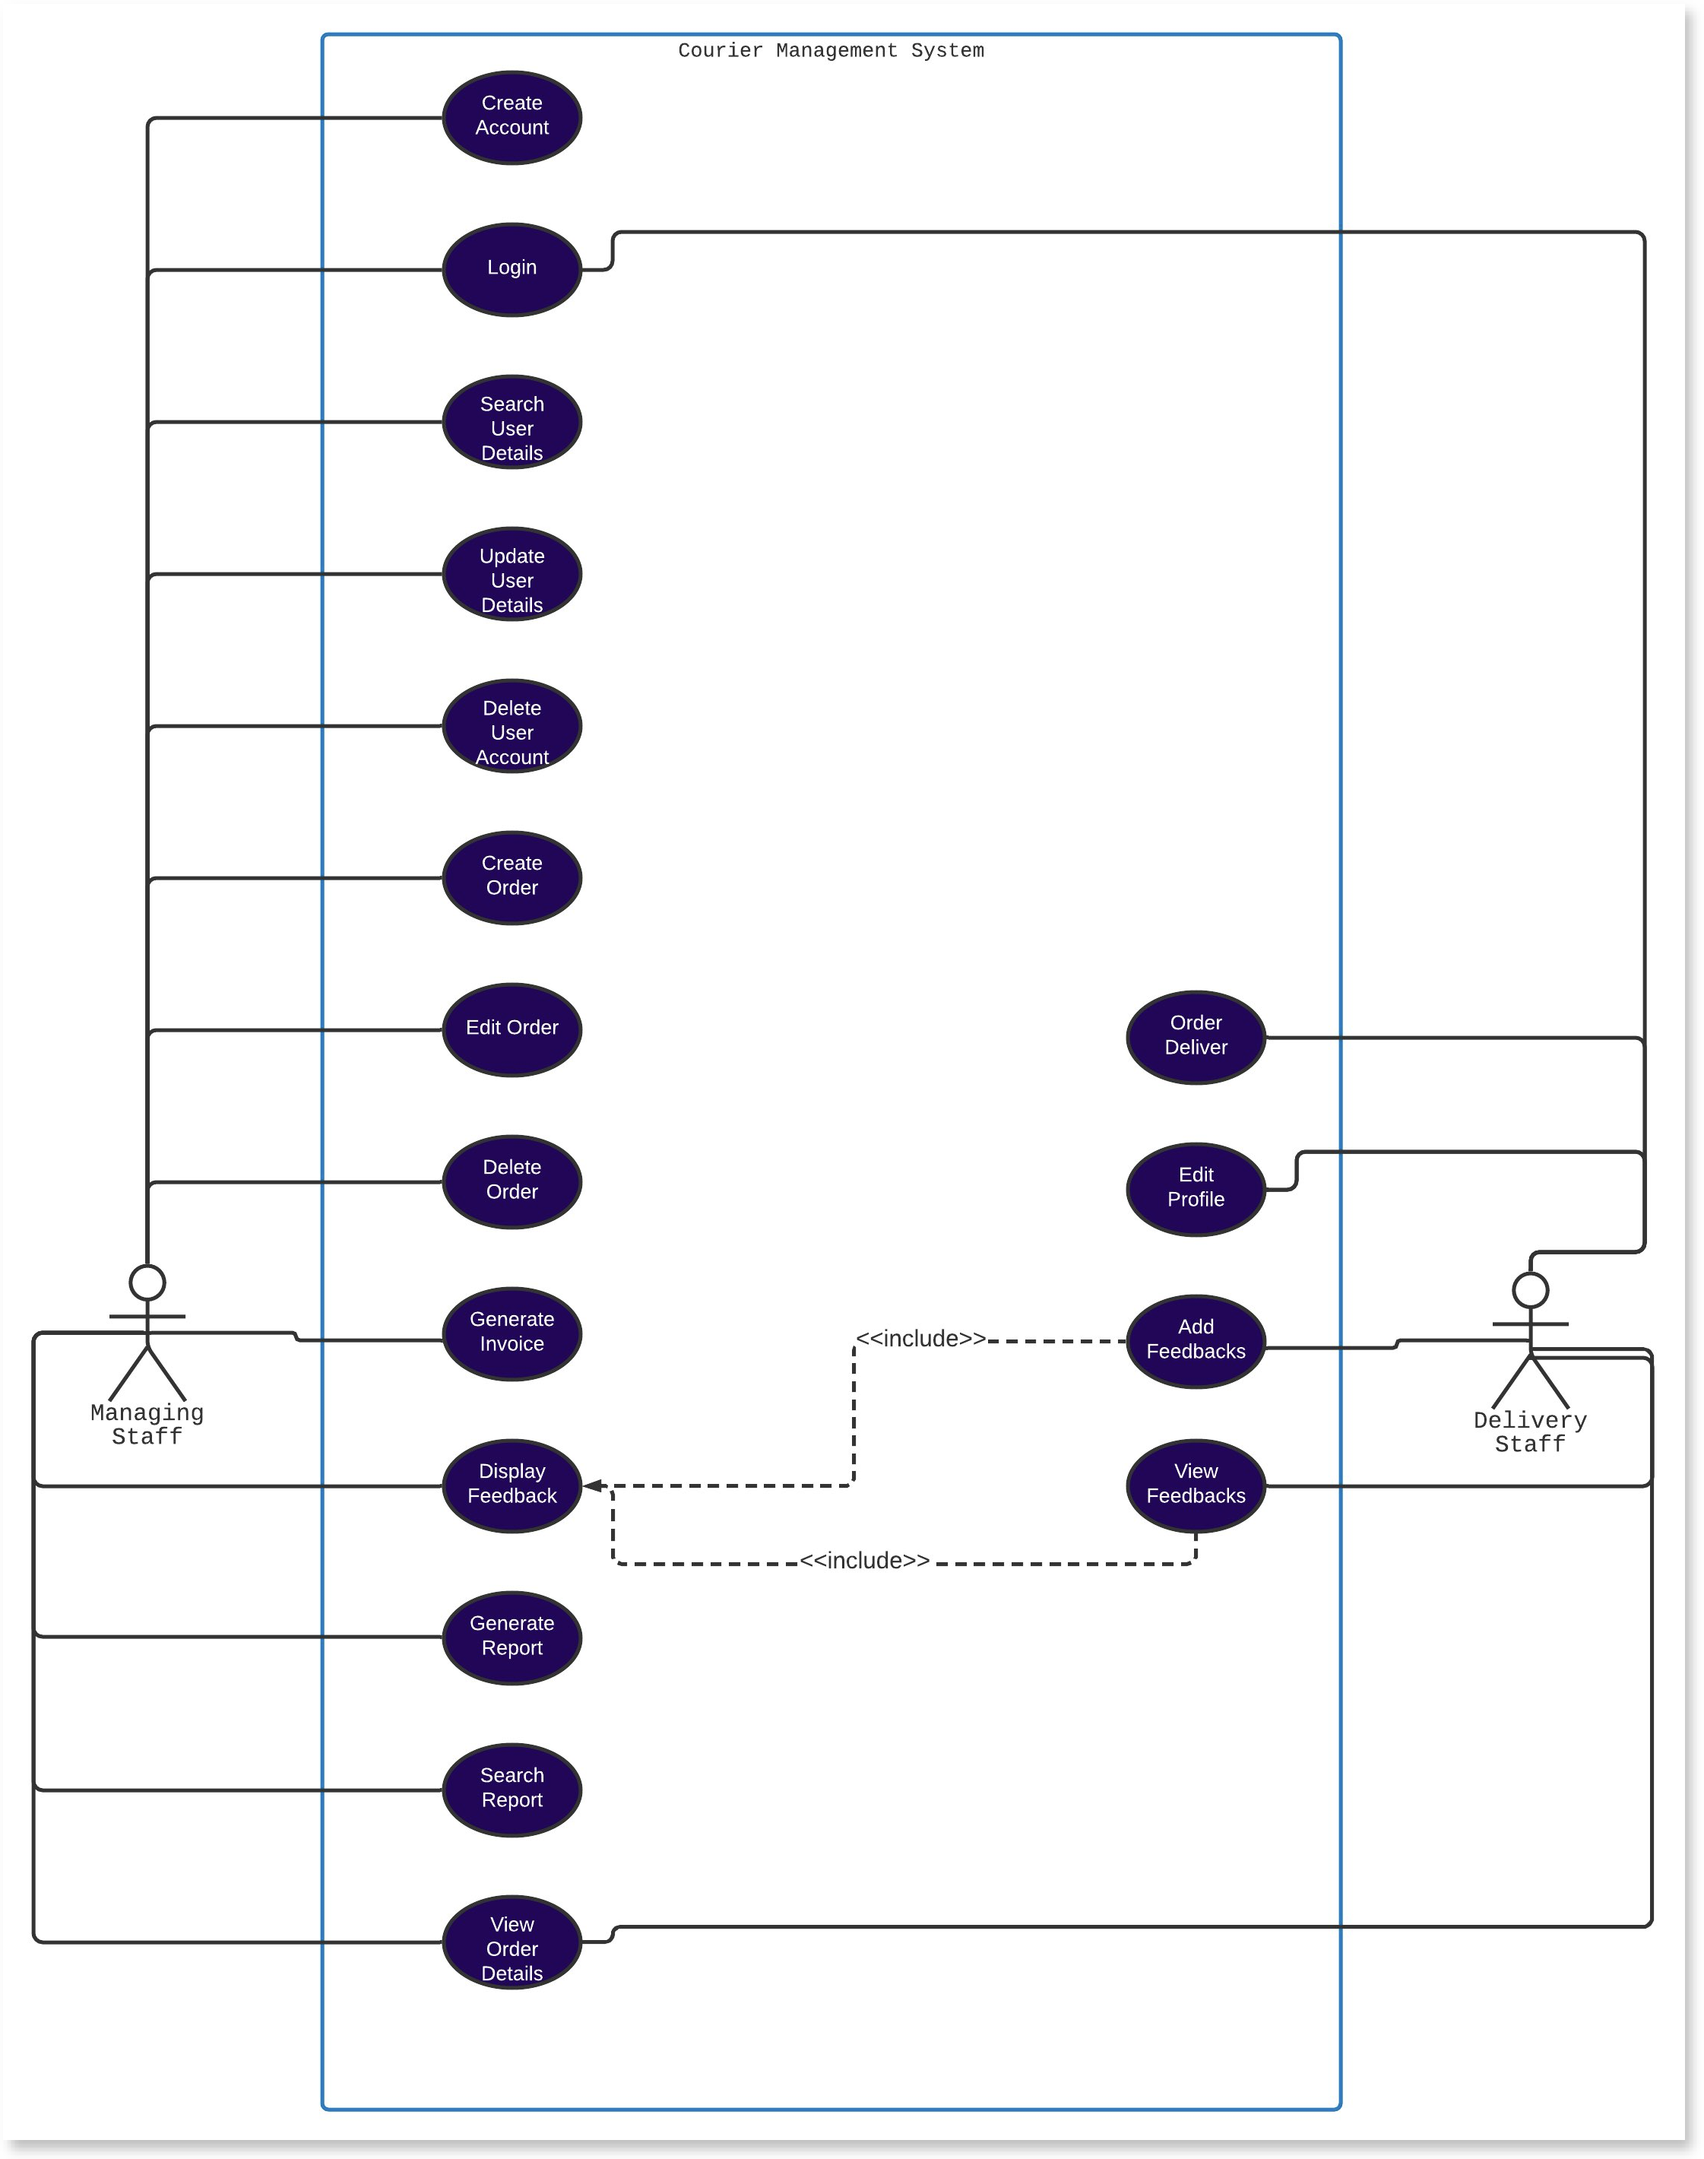
UML Diagrams
1. Use Case Diagram

Slide 5
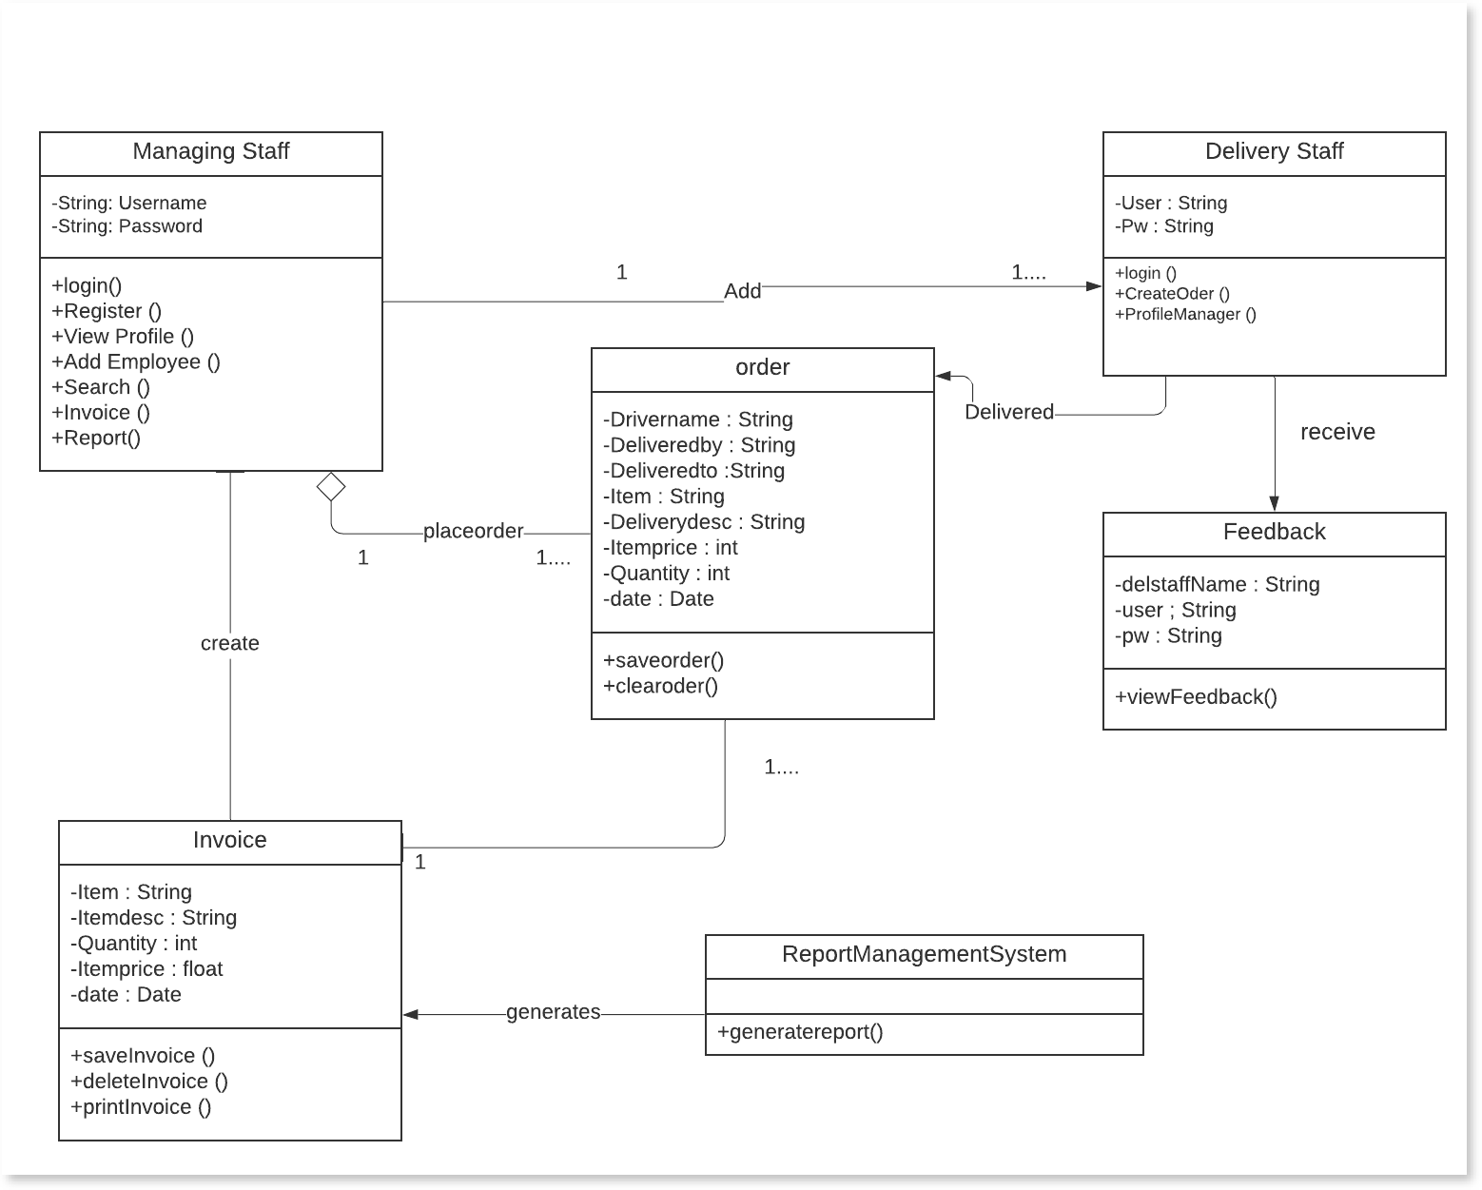
2. Class Diagram

Slide 6

User Roles
Managing Staff
Delivery Staff
Profile Management
Individual Profile Management
Employee Registration
Feedback Management
Order Placement
Order Management
Invoice Generation
Credentials Modifications
Report Management
Feedback Overview
Credentials Modifications

Slide 7
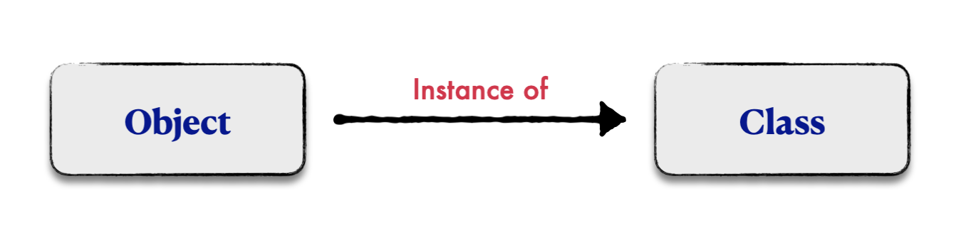
Object Oriented Programming Concepts
Classes
Design that allows us to create objects
Logical entity & No memory allocation
Objects
Real-world entity that has particular state and behavior
Physical entity & Memory allocation

Slide 8
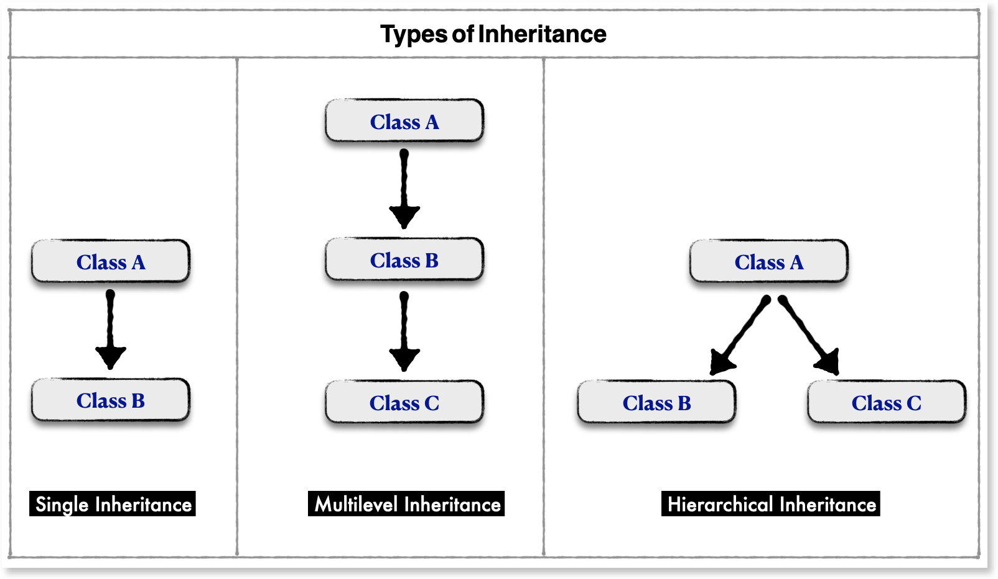
Object Oriented Programming Concepts
1. Inheritance
IS-A Relationship
Inherits property from parent to child class
Code reusability and extensibility
2. Polymorphism
Compile Time
Runtime
Method Overriding
(Static)
(Dynamic)
Method Overloading

Slide 9
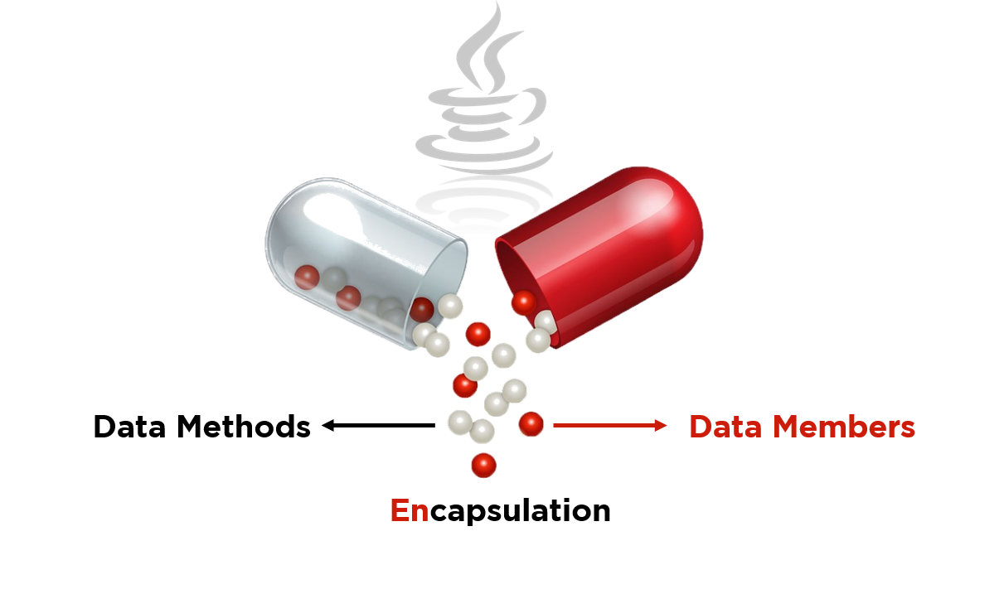
3. Abstraction
Hiding fundamental details and information from users
Abstract Class
Interface
Uncertain
100%
4. Encapsulation
Technique where both data and code are wrapped up under a single unit
Prevents data to be accessed by the code
Private Class
Getters and Setters

Slide 10
Object Oriented Programming Concepts
Advantages of OOPs Concept
The natural and practical technique in OOP makes problem solving practice effectual.
Reusability & extensible of objects in OOP authorizes lower cost and swift development.
Data hiding with private class helps programmers to build a secured system.
OOPs flexibility lets same functions and operators be used multiple times.

Slide 11
System Limitations
Delivery login can be cracked as mobile number is used
File based data storing can be vulnerable
Future Enhancements
To make system available for customer use
To append goods receiving functionalities
Introducing online payment facilities for customers’ ease

Slide 12
Conclusion
Use of Java Programming Language for project construction
Demonstrated knowledge of Object-Oriented Programming
Overall system depicts the importance of technology and use of it

Slide 13
References
GeeksforGeeks. (2021, August 2). Encapsulation in Java. https://www.geeksforgeeks.org/encapsulation-in-java/
How to Use a Constructor in Java. (2016, March 26). Dummies. https://www.dummies.com/programming/java/how-to-use-a-constructor-in-+java/#:%7E:text=A%20constructor%20in%20Java%20is,of%20an%20object%20is%20created.&text=A%+20constructor%20doesn't%20have,considered%20members%20of%20a%20class.
Javatpoint. (n.d.). Object in Java | Class in Java - javatpoint. Www.Javatpoint.Com. Retrieved July 9, 2021, from https://www.javatpoint.com/object-and-class-in-java
Schoeberl, M., Korsholm, S., Kalibera, T., & Ravn, A. P. (2011). A Hardware Abstraction Layer in Java. ACM Transactions on Embedded Computing Systems, 10(4), 1–40. https://doi.org/10.1145/2043662.2043666
Simmel, S. (1992). Object-based visual programming languages. OOPS, 3(4), 99. https://doi.org/10.1145/143776.270578
Sinicki, A. (2017, March 13). What is Object Oriented Programming? Android Authority. https://www.androidauthority.com/object-oriented-programming-755216/
V. MEHTRE, V. I. S. H. A. L., & NIGAM, Y. A. S. H. (2019b). Review on Concepts Related to Object Oriented Programming System. ICONIC RESEARCH AND ENGINEERING JOURNALS, 3(6), 56–58. https://www.irejournals.com/formatedpaper/1701801.pdf
Vitek, J. (2008). ECOOP 2008 - Object-Oriented Programming. Springer Publishing. https://doi.org/10.1007/978-3-540-70592-5_28

Slide 14
Thank You !
END OF PRESENTATION

